Slide 1
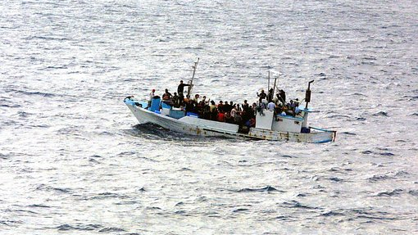
Migration Worldwide
Final Data Analytics Project
Matías Grob
February 2023

Slide 2
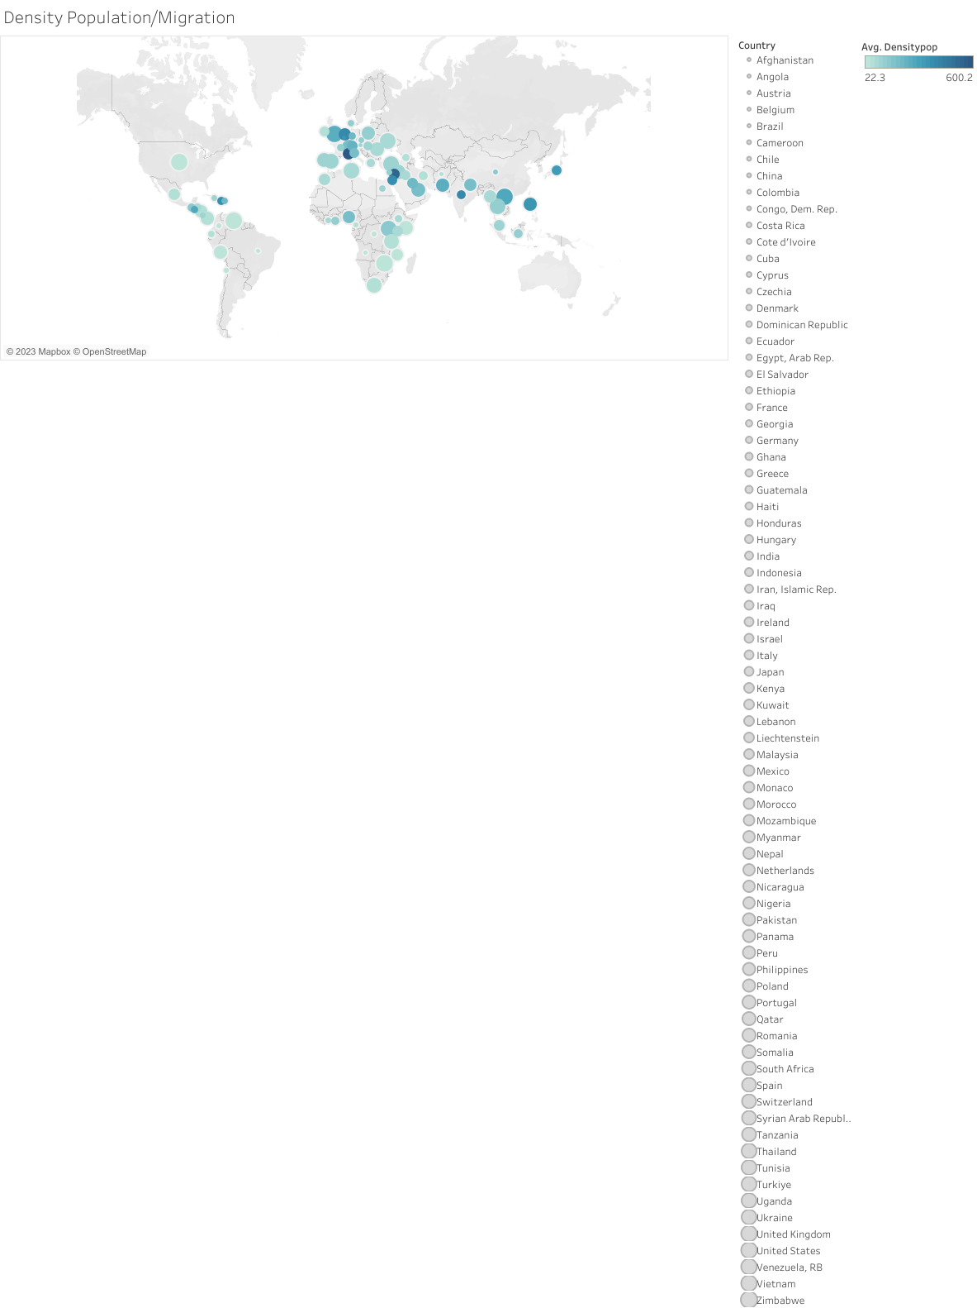

Slide 3
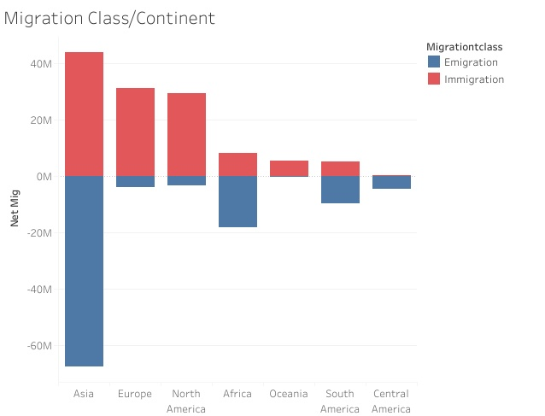



Slide 4
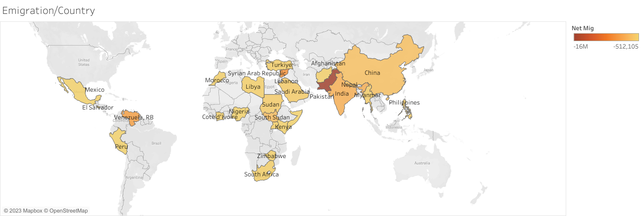

Slide 5
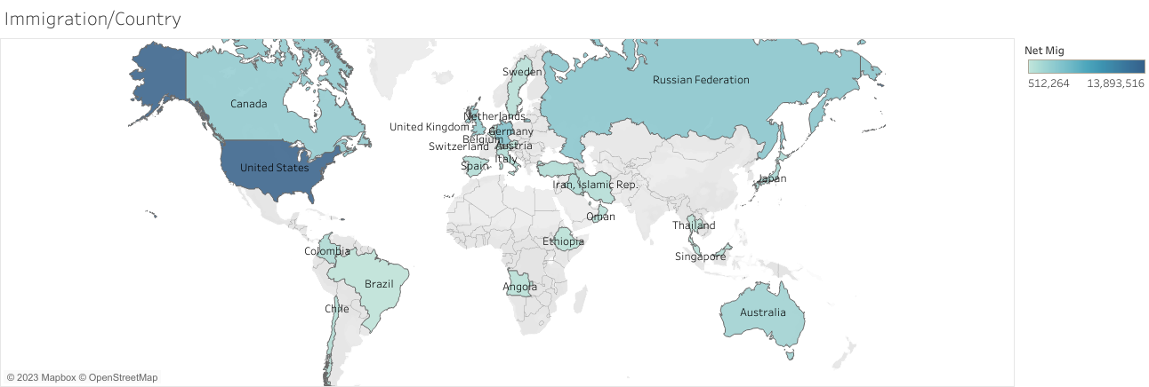

Slide 6
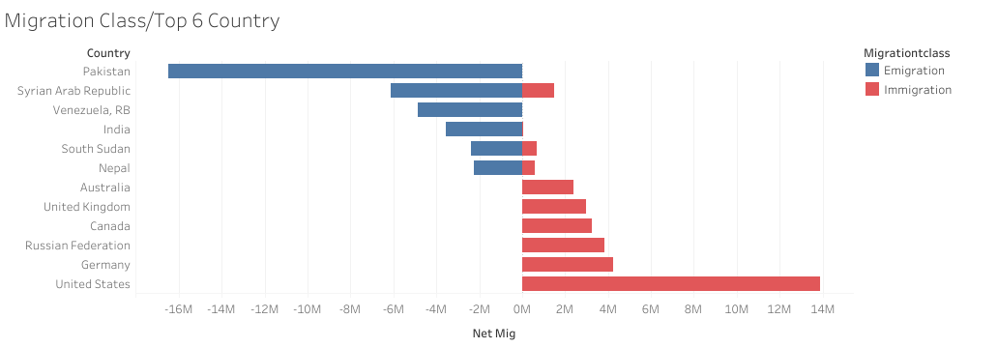
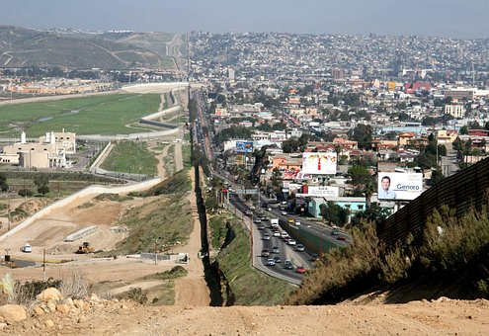


Slide 7
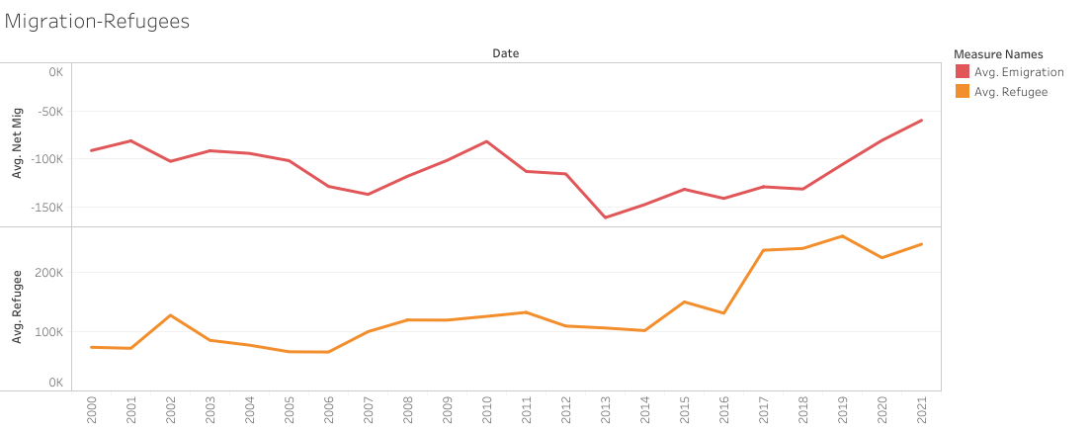

Slide 8
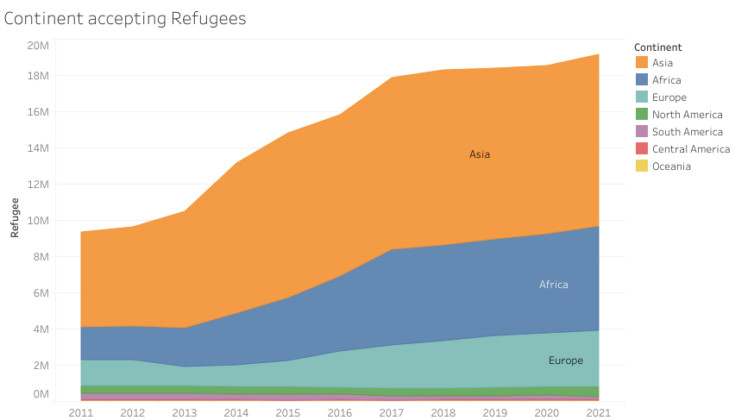



Slide 9
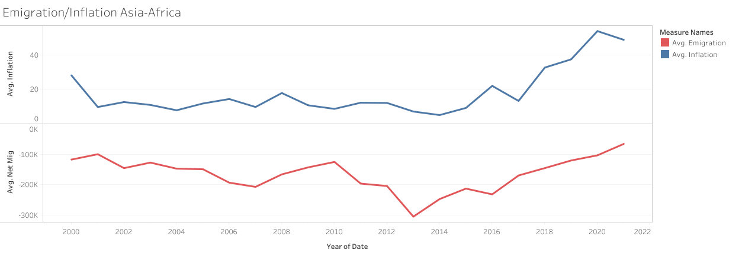

Slide 10
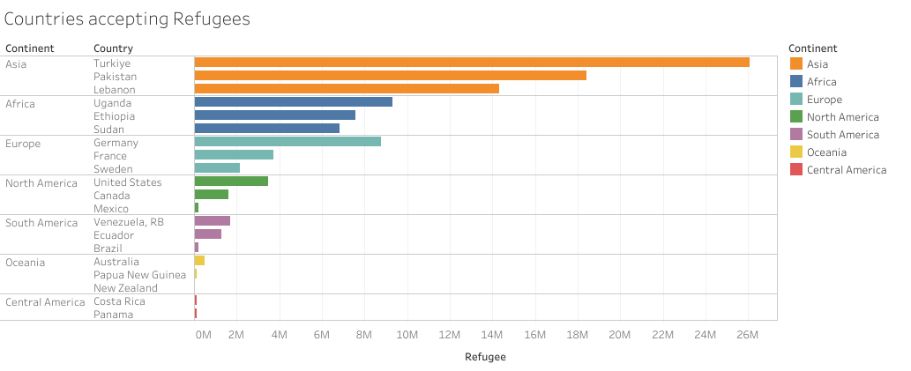

Slide 11

Conclusions
The biggest movements in migration happen within the continents (Asia & Africa case).
Political, Economic, and Demographic indicators can explain Migration trends.
War, Political Instability and Social-Economic Crisis among relevant factors.

Slide 12

Thank you!

